Slide 1
Foundations of Machine Learning
Module 8: Ensemble Learning
Part A
Sudeshna Sarkar
IIT Kharagpur

Slide 2
What is Ensemble Classification?
Use multiple learning algorithms (classifiers)
Combine the decisions
Can be more accurate than the individual classifiers
Generate a group of base-learners
Different learners use different
Algorithms
Hyperparameters
Representations (Modalities)
Training sets

Slide 3
Why should it work?
Works well only if the individual classifiers disagree
Error rate < 0.5 and errors are independent
Error rate is highly correlated with the correlations of the errors made by the different learners

Slide 4
Bias vs. Variance
We would like low bias error and low variance error
Ensembles using multiple trained (high variance/low bias) models can average out the variance, leaving just the bias
Less worry about overfit (stopping criteria, etc.) with the base models
Notes:
for mixed it is 1-binomial assuming majority event is a model getting it wrong

Slide 5
Combining Weak Learners
Combining weak learners
Assume n independent models, each having accuracy of 70%.
If all n give the same class output then you can be confident it is correct with probability 1-(1-.7)^{n}.
Normally not completely independent, but unlikely that all n would give the same output
Accuracy better than the base accuracy of the models by using the majority output.
If n1 models say class 1 and n2<n1 models say class 2, then
P(class1) = 1 – Binomial(n, n2, .7)

Slide 6
Ensemble Creation Approaches
Get less correlated errors between models
Injecting randomness
initial weights (eg, NN), different learning parameters, different splits (eg, DT) etc.
Different Training sets
Bagging, Boosting, different features, etc.
Forcing differences
different objective functions
Different machine learning model

Slide 7
Ensemble Combining Approaches
Unweighted Voting (e.g. Bagging)
Weighted voting – based on accuracy (e.g. Boosting), Expertise, etc.
Stacking - Learn the combination function

Slide 8
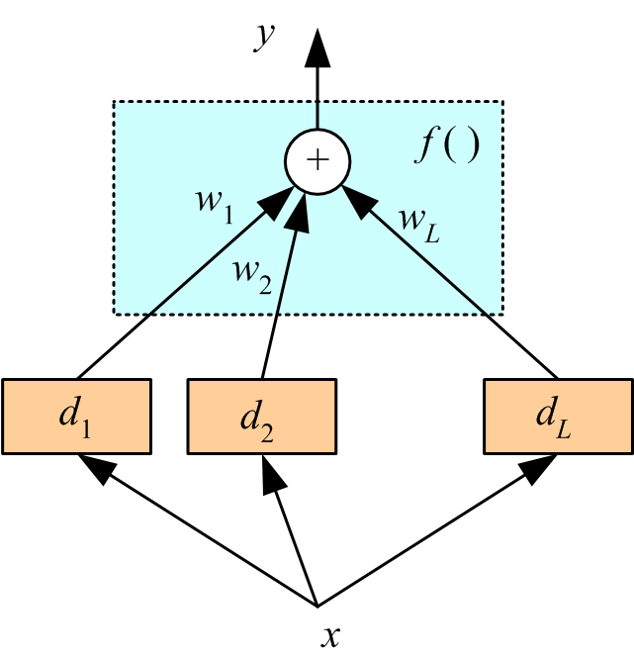

Combine Learners: Voting
Unweighted voting
Linear combination (weighted vote)
weight $∝$ accuracy
weight $∝$ $1/{variance}$
Bayesian

Slide 9
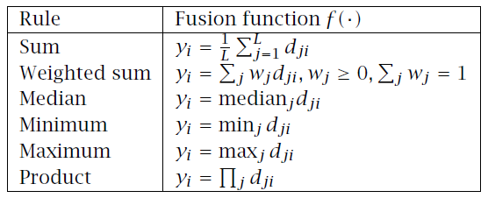
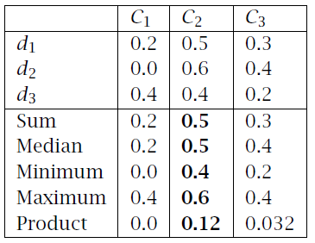
Fixed Combination Rules

Slide 10

Bayes Optimal Classifier
The Bayes Optimal Classifier is an ensemble of all the hypotheses in the hypothesis space.
On average, no other ensemble can outperform it.
The vote for each hypothesis
proportional to the likelihood that the training dataset would be sampled from a system if that hypothesis were true.
is multiplied by the prior probability of that hypothesis.

Slide 11
y is the predicted class,
C is the set of all possible classes,
H is the hypothesis space,
T is the training data.
The Bayes Optimal Classifier represents a hypothesis that is not necessarily in H.
But it is the optimal hypothesis in the ensemble space.

Slide 12
Practicality of Bayes Optimal Classifier
Cannot be practically implemented.
Most hypothesis spaces are too large
Many hypotheses output a class or a value, and not probability
Estimating the prior probability for each hypothesizes is not always possible.

Slide 13
BMA
All possible models in the model space used weighted by their probability of being the “Correct” model
Optimal given the correct model space and priors

Slide 14
Why are Ensembles Successful?
Bayesian perspective:
If d_{j} are independent
Bias does not change, variance decreases by L
If dependent, error increase with positive correlation

Slide 15
General Idea

Slide 16
Challenge for developing Ensemble Models
The main challenge is to obtain base models which are independent and make independent kinds of errors.
Independence between two base classifiers can be assessed in this case by measuring the degree of overlap in training examples they misclassify (|A ∩B|/|A∪B|)

Slide 17
Thank You

Slide 18
Foundations of Machine Learning
Module 8: Ensemble Learning
Part B: Bagging and Boosting
Sudeshna Sarkar
IIT Kharagpur

Slide 19
Bagging
Bagging = “bootstrap aggregation”
Draw N items from X with replacement
Desired learners with high variance (unstable)
Decision trees and ANNs are unstable
K-NN is stable
Use bootstrapping to generate L training sets and train one base-learner with each (Breiman, 1996)
Use voting

Slide 20
Bagging
Sampling with replacement
Build classifier on each bootstrap sample
Each sample has probability (1 – 1/n)^{n} of being selected

Slide 21
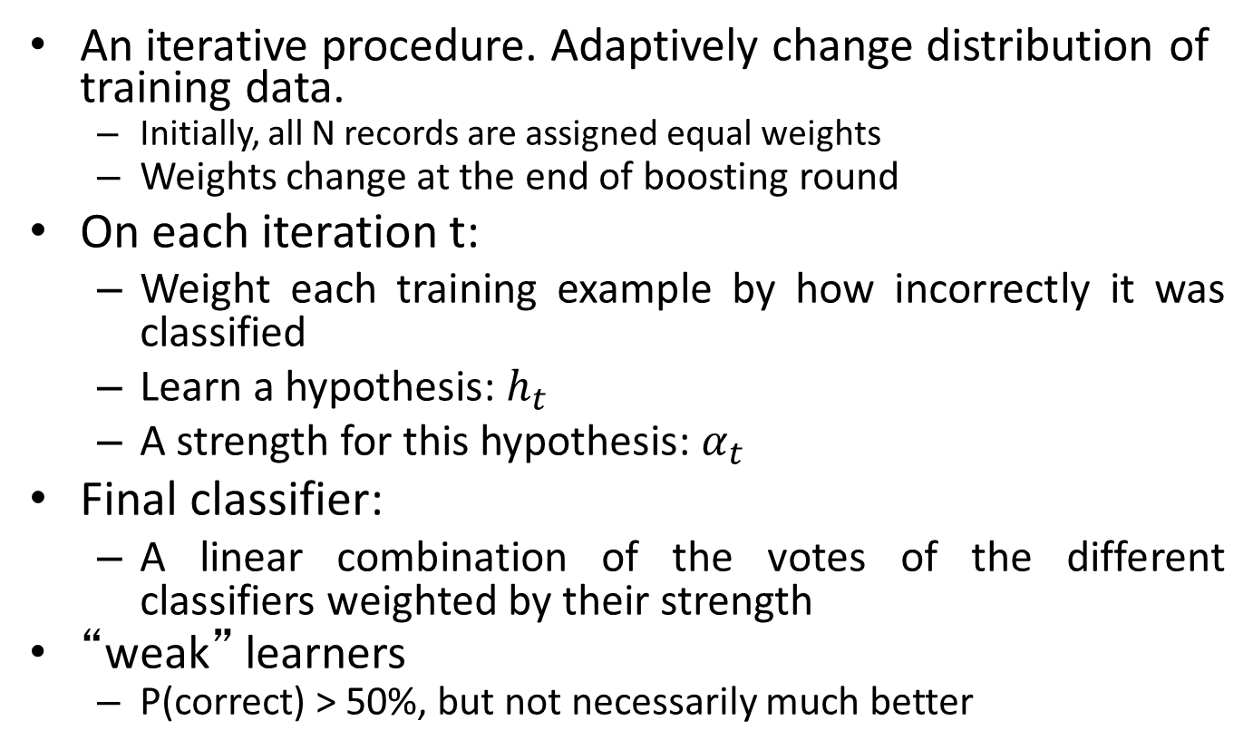
Boosting
An iterative procedure. Adaptively change distribution of training data.
Initially, all N records are assigned equal weights
Weights change at the end of boosting round
On each iteration t:
Weight each training example by how incorrectly it was classified
Learn a hypothesis: $h_{t}$
A strength for this hypothesis: $α_{t}$
Final classifier:
A linear combination of the votes of the different classifiers weighted by their strength
“weak” learners
P(correct) > 50%, but not necessarily much better

Slide 22
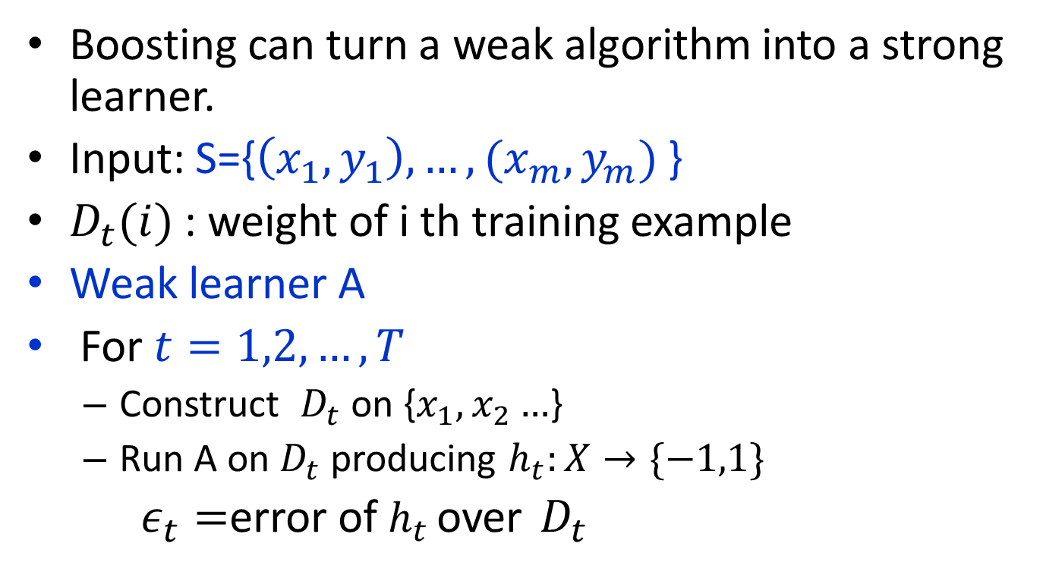
Adaboost
Boosting can turn a weak algorithm into a strong learner.
Input: S={$\left(x_{1},y_{1}\right),…,(x_{m},y_{m})$ }
$D_{t}(i)$ : weight of i th training example
Weak learner A
For $t=1,2,…,T$
Construct $D_{t}$ on {$x_{1},x_{2}…$}
Run A on $D_{t}$ producing $h_{t}:X→\{−1,1\}$
$ε_{t}=$error of $h_{t}$ over $D_{t}$

Slide 23
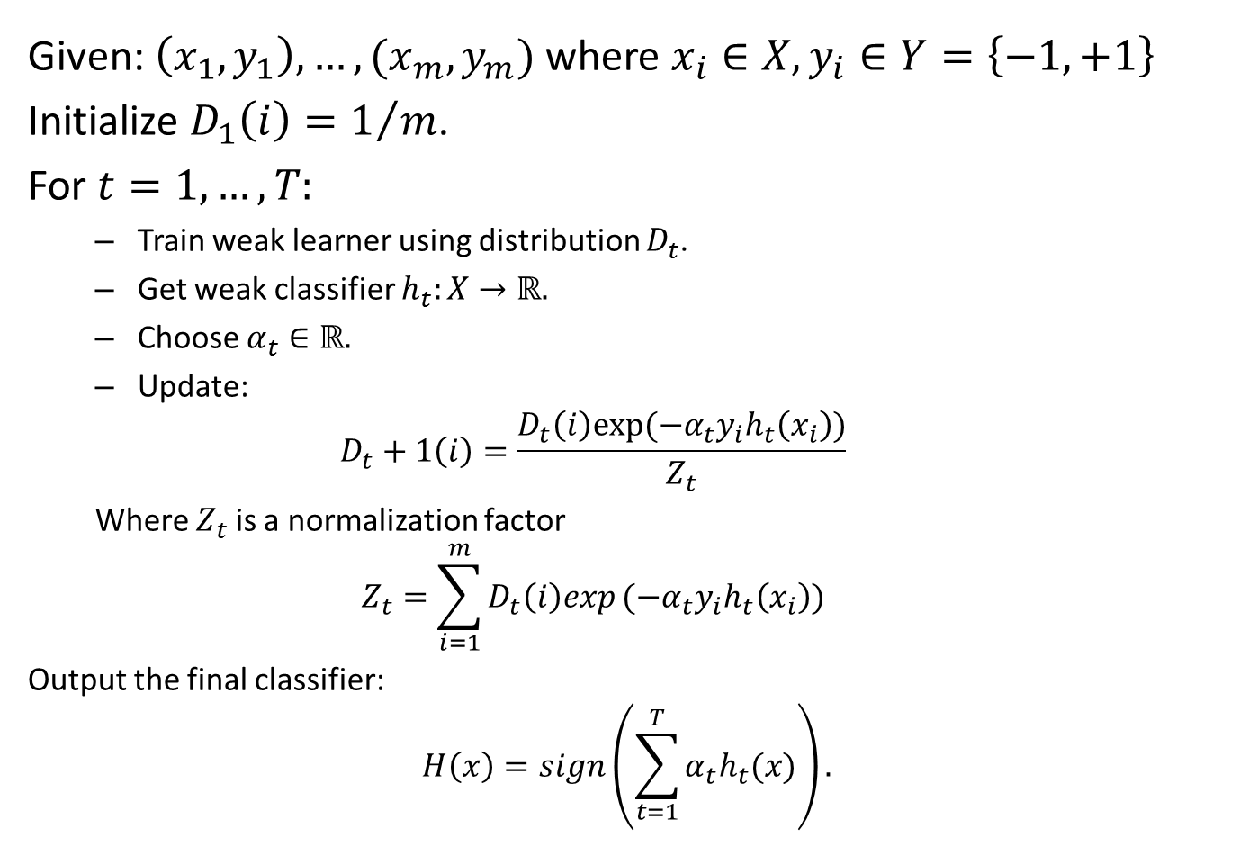
Given: $\left(x_{1},y_{1}\right),…,(x_{m},y_{m})$ where $x_{i}∈X,y_{i}∈Y=\left\{−1,+1\right\}$
Initialize $D_{1}\left(i\right)=1/m$.
For $t=1,…,T:$
Train weak learner using distribution $D_{t}$.
Get weak classifier $h_{t}:X→ℝ.$
Choose $α_{t}∈ℝ.$
Update:
$$D_{t}+1\left(i\right)=\frac{D_{t}\left(i\right)exp⁡(−α_{t}y_{i}h_{t}\left(x_{i}\right))}{Z_{t}}$$
Where $Z_{t}$ is a normalization factor
$$Z_{t}=\sum_{i=1}^{m}{D_{t}\left(i\right)exp}(−α_{t}y_{i}h_{t}\left(x_{i}\right))$$
Output the final classifier:
$$H\left(x\right)=sign\left(\sum_{t=1}^{T}{α_{t}h_{t}(x)}\right).$$

Slide 24
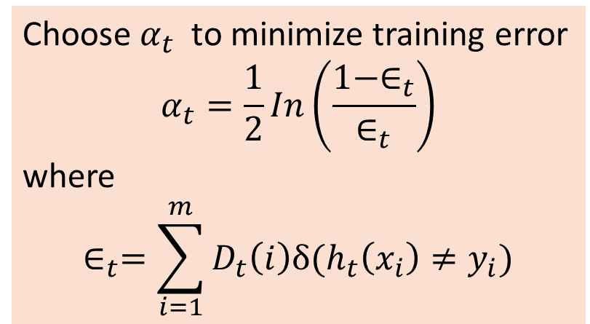
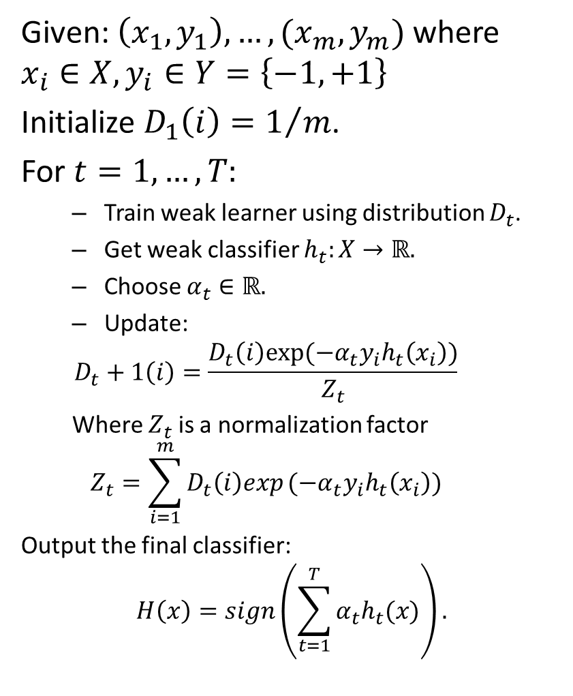
Given: $\left(x_{1},y_{1}\right),…,(x_{m},y_{m})$ where $x_{i}∈X,y_{i}∈Y=\left\{−1,+1\right\}$
Initialize $D_{1}\left(i\right)=1/m$.
For $t=1,…,T:$
Train weak learner using distribution $D_{t}$.
Get weak classifier $h_{t}:X→ℝ.$
Choose $α_{t}∈ℝ.$
Update:
$$D_{t}+1\left(i\right)=\frac{D_{t}\left(i\right)exp⁡(−α_{t}y_{i}h_{t}\left(x_{i}\right))}{Z_{t}}$$
Where $Z_{t}$ is a normalization factor
$$Z_{t}=\sum_{i=1}^{m}{D_{t}\left(i\right)exp}(−α_{t}y_{i}h_{t}\left(x_{i}\right))$$
Output the final classifier:
$$H\left(x\right)=sign\left(\sum_{t=1}^{T}{α_{t}h_{t}(x)}\right).$$
Choose${ α}_{t}$ to minimize training error
$$α_{t}=\frac{1}{2}In\left(\frac{1−∈_{t}}{∈_{t}}\right)$$
where
$$∈_{t}=\sum_{i=1}^{m}{D_{t}\left(i\right)δ⁡(h_{t}\left(x_{i}\right)≠y_{i})}$$

Slide 25
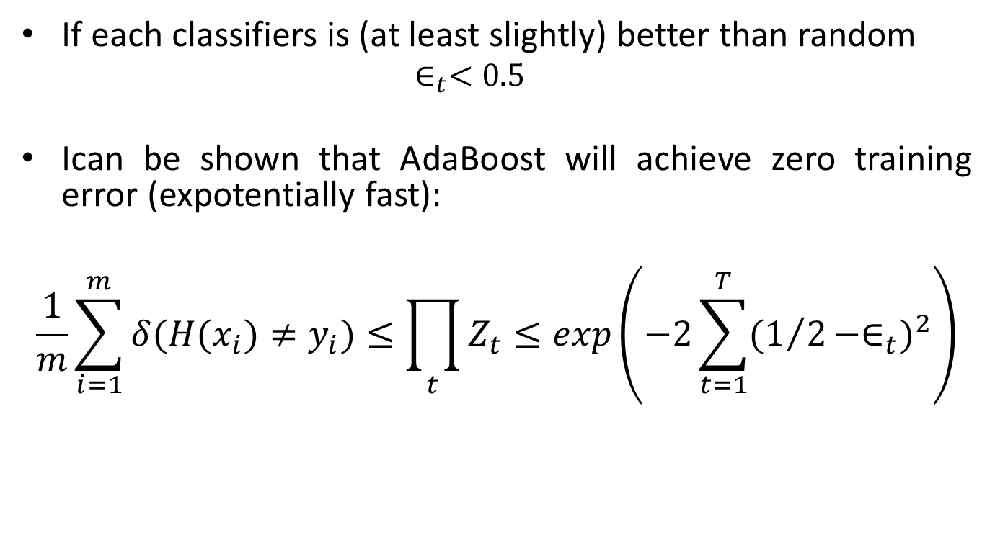
Strong weak classifiers
If each classifiers is (at least slightly) better than random
$$∈_{t}<0.5$$
Ican be shown that AdaBoost will achieve zero training error (expotentially fast):
$$\frac{1}{m}\sum_{i=1}^{m}{δ(H(x_{i})≠y_{i})≤\prod_{t}{Z_{t}≤exp\left(−2\sum_{t=1}^{T}{(1/2−∈_{t})^{2}}\right)}}$$

Slide 26
Illustrating AdaBoost
Initial weights for each data point
Data points for training

Slide 27
Illustrating AdaBoost

Slide 28
Thank You

